Slide 1
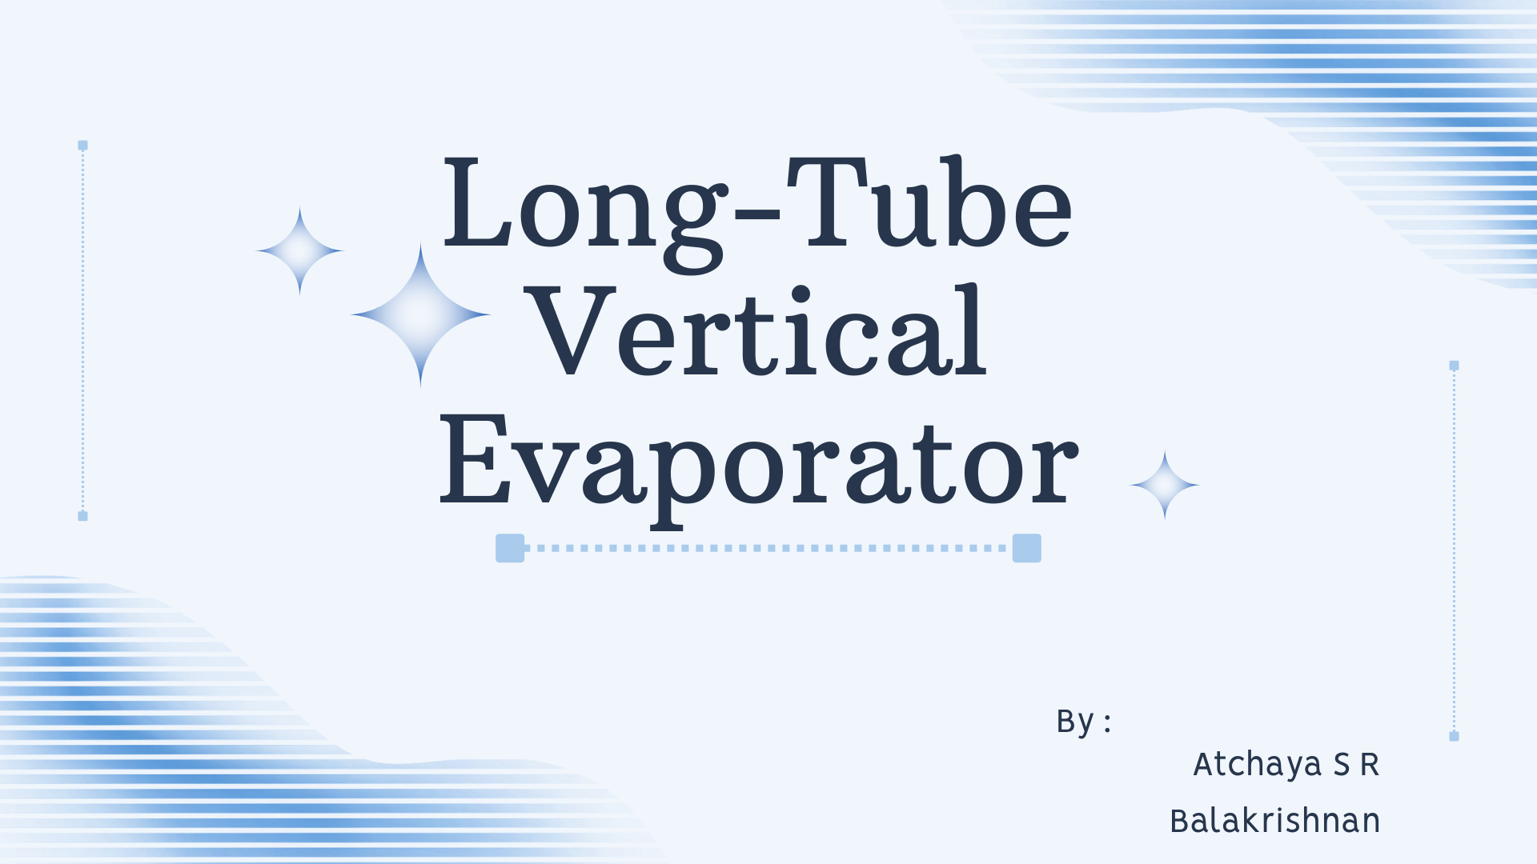
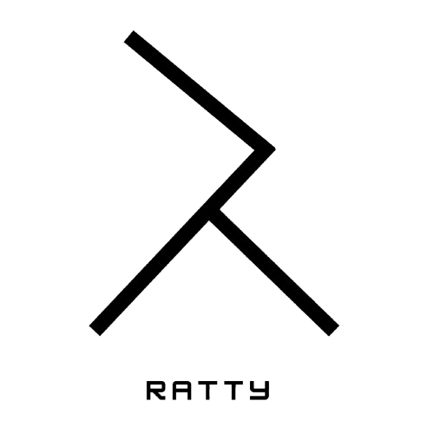

Slide 2

Long Tube Vertical Evaporator
A Long Tube Vertical Evaporator (LTVE) is a natural circulation evaporator.
It is used to remove water from liquids by boiling to concentrate them.
It has long vertical tubes heated by steam from the outside

Slide 3
Working Principle
Natural circulation: liquid rises due to density difference as It heats and boils.
Liquid enters at the bottom of tubes.
Steam outside the tubes transfers heat and causes boiling inside the tubes.
Vapor and liquid move upward to a vapor separator at the top.
Vapor exits and the concentrated liquid is withdrawn.

Slide 4
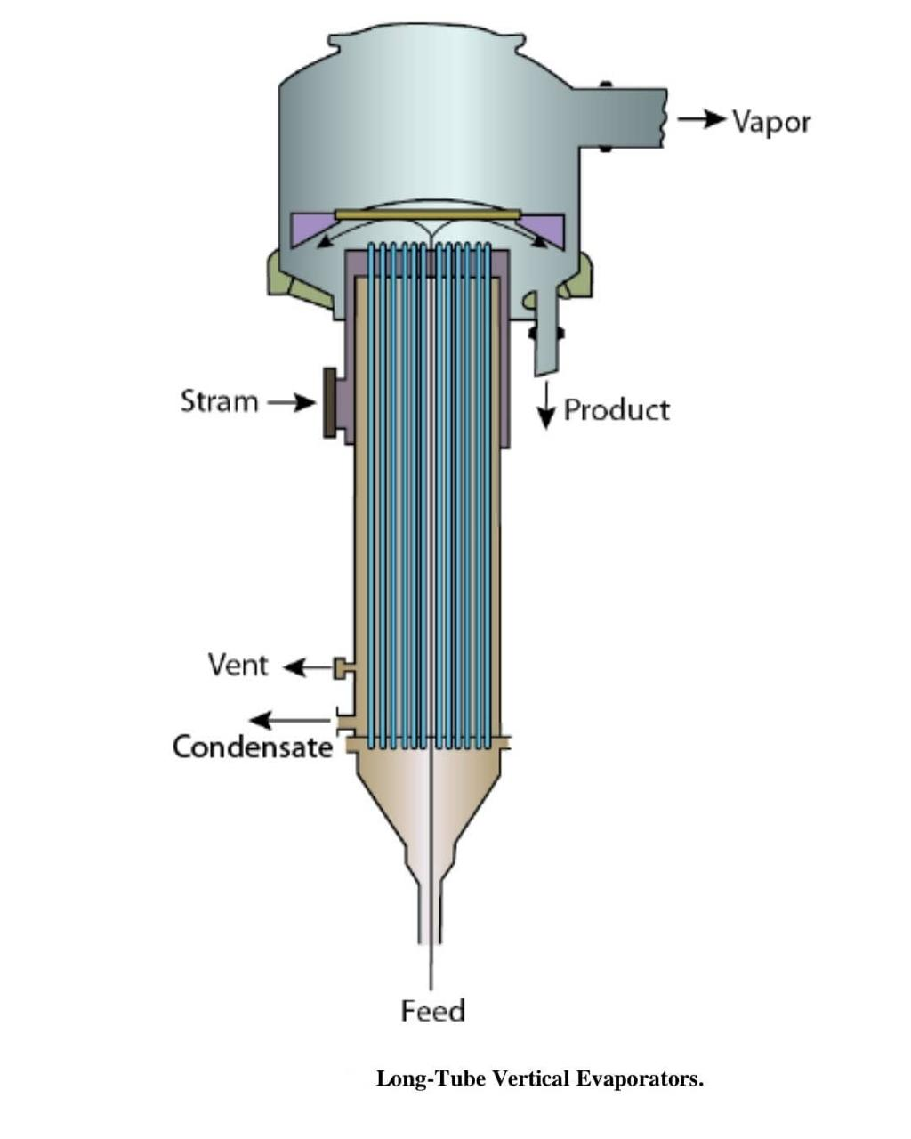

Slide 5
Applications
1. Milk and dairy products.
2. Fruit juices and similar food liquids.
3. Sugar syrups and cane juice.
4. Foaming liquids and frothy solutions.
5. Corrosive solutions suitable for vertical tube design.
6. Large evaporation loads in chemical/industrial processes.

Slide 6
Advantages
High heat transfer coefficient (good efficiency).
Low liquid holdup (short residence time).
Small floor space requirement.
Good for heat-sensitive liquids .
No pump needed (natural circulation).
Can handle foamy liquids

Slide 7
Disadvantages
Requires high head-room (tall equipment).
Not suitable for very viscous liquids.
Scaling/liquid deposits inside tubes are hard to clean.
Sometimes needs recirculation for better performance.
Hydrostatic head may raise product temperature.

Slide 8


